Slide 1
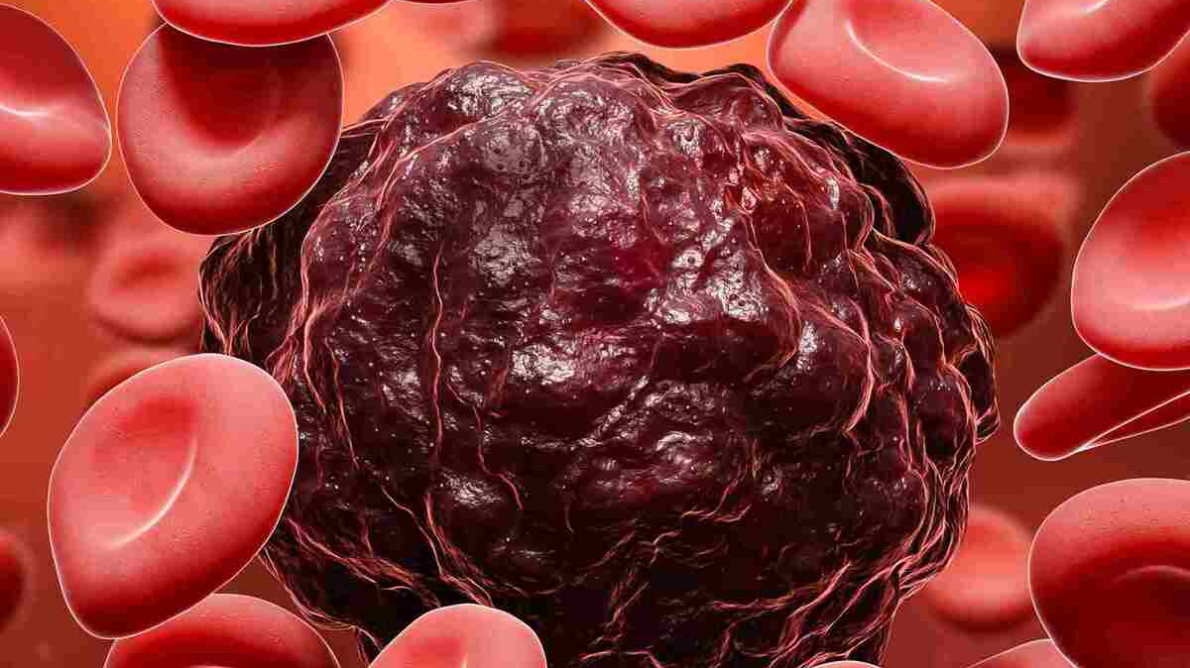
Blood Cells Cancer Detection Using Vision Transformer
Exploring Advanced Image Processing Techniques
Name: Srikanth Uriti
Student ID: 22028166

Slide 2
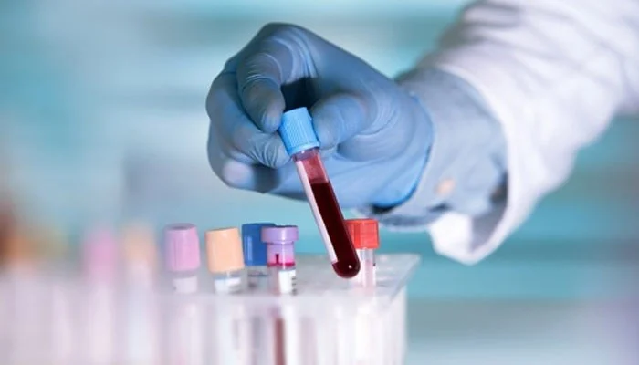
Aim & Objectives
Aim:
To develop an efficient model for detecting Acute Lymphoblastic Leukemia (ALL) using Vision Transformer (ViT) architecture combined with Entropy Filtering and Region Growing Segmentation.
Objectives:
Develop a reliable ViT-based classification model.
Enhance image quality through preprocessing.
Use a labelled dataset of peripheral blood smear images for training.
Improve diagnostic accuracy for early detection and treatment planning.

Slide 3
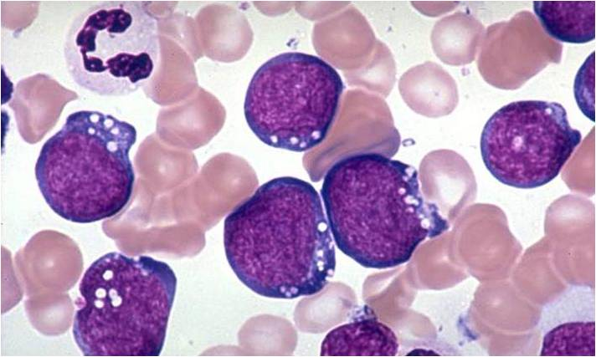
Background
Traditional diagnostic methods for detecting Acute Lymphoblastic Leukemia (ALL) often rely on convolutional neural networks (CNNs), which may struggle with capturing complex image relationships and providing accurate classifications. In contrast, this research utilizes the Vision Transformer (ViT) model, which excels in understanding global image features for superior accuracy.
To enhance image quality and segmentation, we integrate advanced preprocessing techniques, including:
Entropy Filtering: Enhances visibility of blood cell membranes and nuclei.
Region Growing Segmentation: Highlights relevant features in peripheral blood smear (PBS) images.
This combination significantly improves diagnostic precision over older methods.

Slide 4
Research Questions
How does entropy-based feature extraction influence the performance of ViT models in classifying blood cell cancer images?
What impact does region growing segmentation have on the ViT model's ability to distinguish benign and malignant blood cell types?
How do entropy filtering and region growing segmentation improve the precision of ViT-based cancer classification models?
What are the computational trade-offs when using these preprocessing techniques versus raw image inputs?

Slide 5
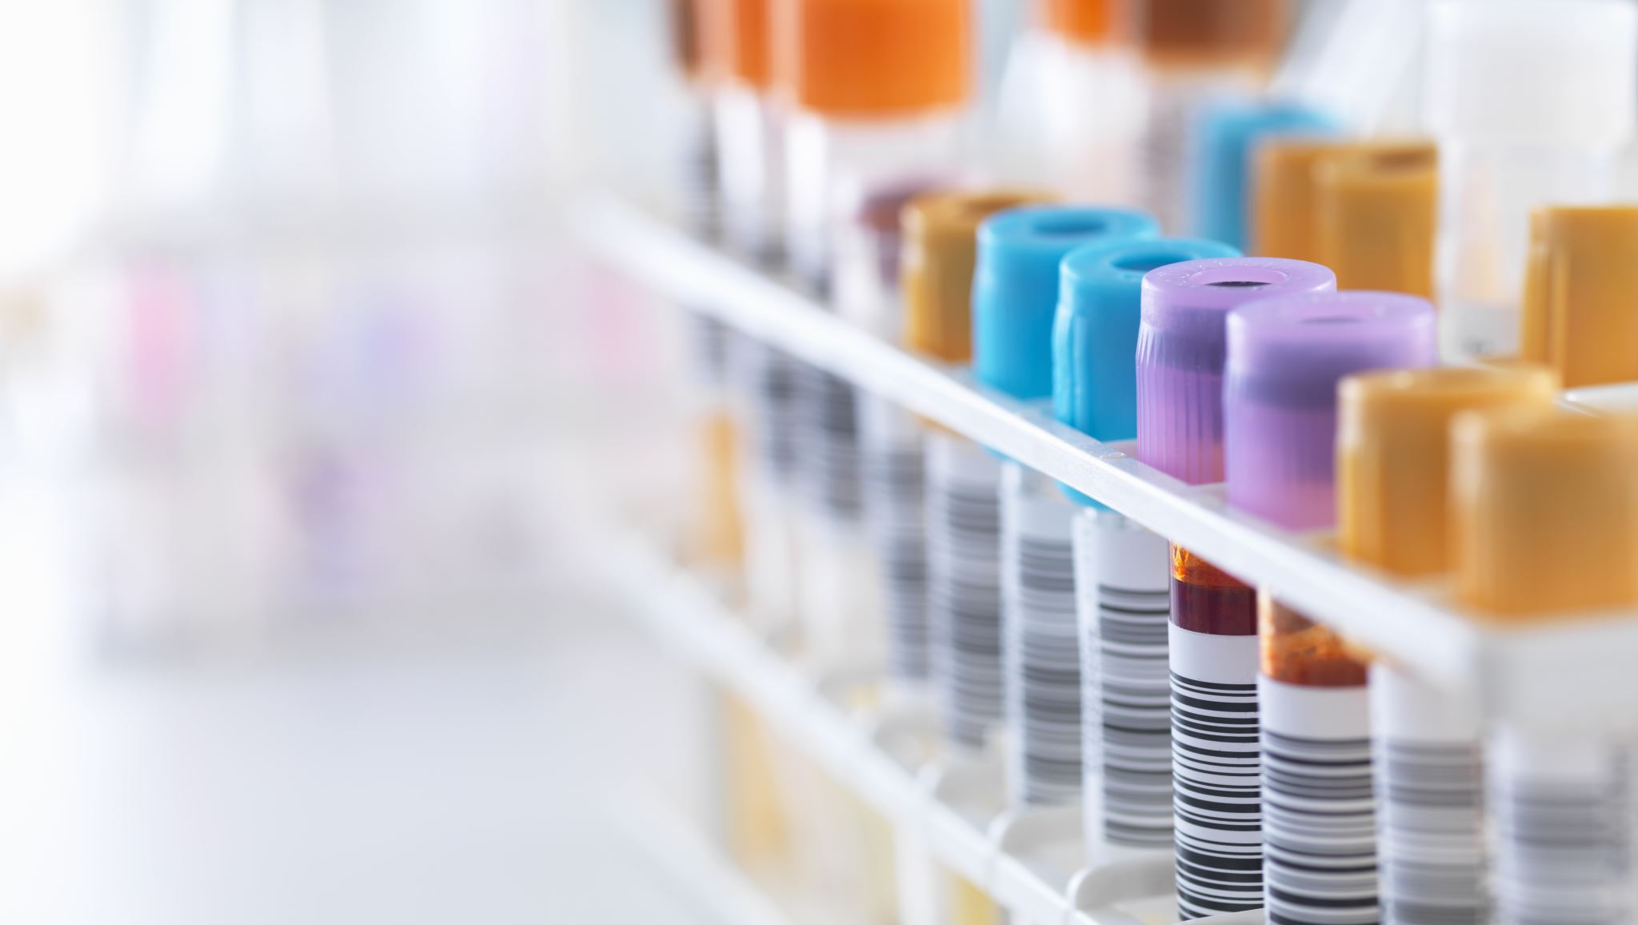
Dataset Overview
• Dataset Link: https://www.kaggle.com/datasets/mohammadamireshraghi/blood-cell-cancer-all-4class
• Source: The images were prepared in the bone marrow laboratory of Taleqani Hospital (Tehran, Iran).
This dataset consists of 3,242 PBS images from 89 patients suspected of Acute Lymphoblastic Leukemia (ALL).
• Class Distribution:
- Benign: Hematogenous cells.
- Malignant: Divided into three subtypes:
- Early Pre-B ALL
- Pre-B ALL
- Pro-B ALL
• Image Quality: Captured with a Zeiss camera at 100x magnification, ensuring high quality.

Slide 6

Ethical Considerations
GDPR Compliance:
The dataset is anonymized and excludes personally identifiable information, exempting it from GDPR regulations.
Conformance to UH Ethical Policies:
Aligns with ethical guidelines by using publicly available data, ensuring responsible information use.
Permission for Data Use:
The dataset is openly accessible on Kaggle, with permission granted for research and educational use.
Ethical Data Collection:
Collected ethically by qualified professionals at Taleqani Hospital using flow cytometry and skilled staff for accurate labeling and processing.
Licensing:
Licensed under Creative Commons Attribution-NonCommercial 4.0 International License (CC BY-NC 4.0), permitting non-commercial use with proper attribution.

Slide 7
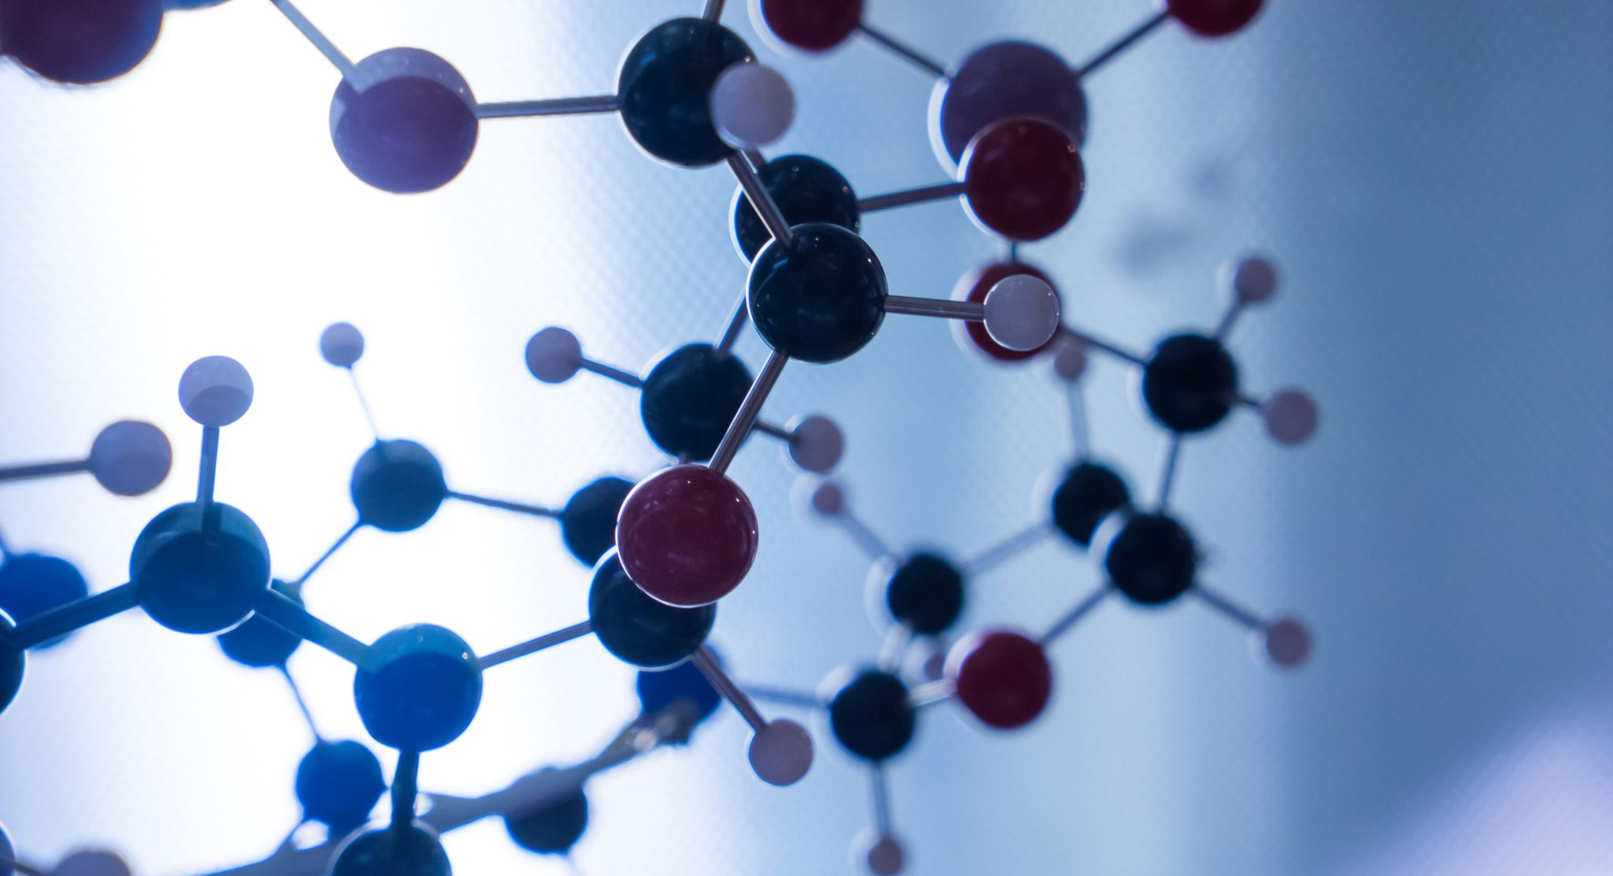
Methodology
1. Data Collection
2. Model Architecture:
Vision Transformer (ViT): Used for classifying the segmented and preprocessed images into benign and malignant groups, leveraging its ability to capture global image features.
3. Preprocessing Techniques:
Entropy Filtering: It Enhances the visibility of blood cell membranes and nuclei, improving feature extraction.
Region Growing Segmentation: Accurately segments and isolates relevant blood cells from peripheral blood smear (PBS) images.
4. Training and Evaluation:
The model will be trained using the preprocessed dataset and evaluated on key metrics including accuracy, precision, and recall to assess its performance.

Slide 8

Project plan

Slide 9

Conclusion
This research utilizes Vision Transformer (ViT) and advanced preprocessing techniques to improve the early detection of Acute Lymphoblastic Leukemia (ALL) through accurate classification of blood smear images. The model aims to enhance diagnostic accuracy and support timely treatment for better patient outcomes.

